Slide 1
VeADIR: Veritaseum Autonomous Distributed Interactive Research
Technology Demonstration
SEC New York Regional Office
March 9, 2018
Notes:
Introduction to members of team
Reggie Middleton
Eleanor Reid – assists with general operations and strategy implementation
Marilyn Charlot – assists with compliance and risk management
Andrew Smith – CFA/CPA, assists with research, analysis, and strategy

Slide 2
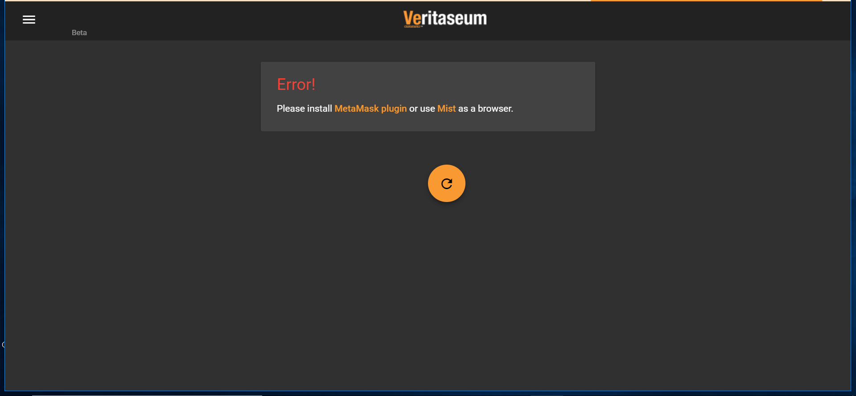
Notes:
Current status of deployment
Selection process
Limitations on beta users’ exposure
Estimation of current beta user exposure and Reggie Middleton’s current exposure through application
Reggie vs. outside user exposure
Approximate number of beta users
(2) MetaMask plugin and Mist browser
Describe MetaMask and Mist
Discuss interaction between MetaMask and VeADIR
Security controls through MetaMask and Mist

Slide 3
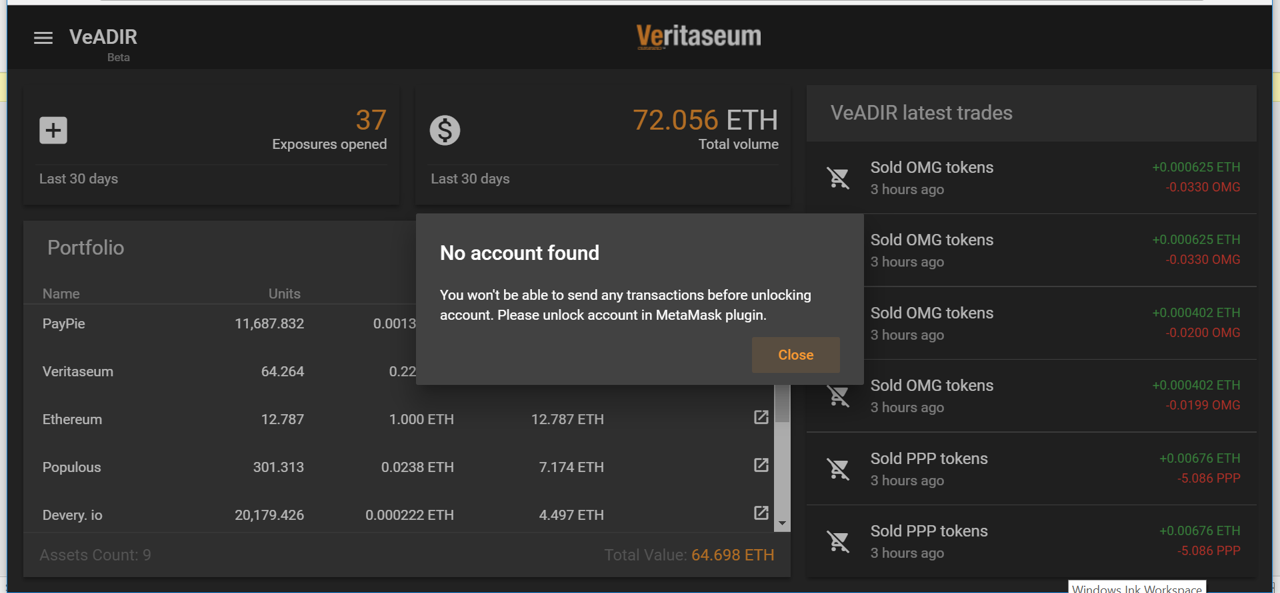
Notes:
Accessing the Application
Describe “no account found”
What do users need to do next?
How are wallets linked to system?

Slide 4
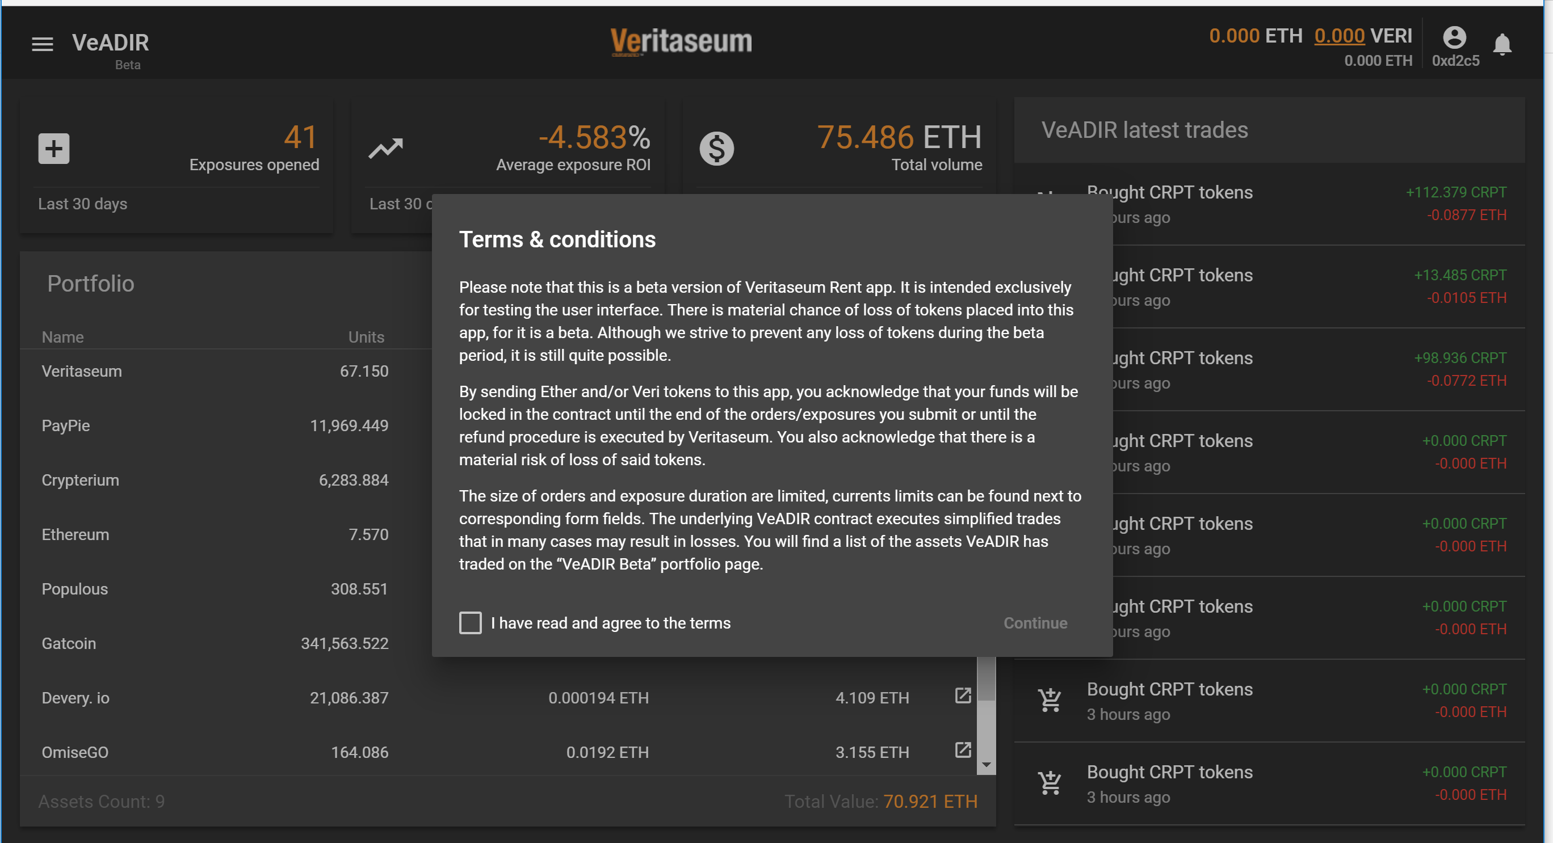
Notes:
View after linking wallet
Disclaimer in Beta Version
What is the “refund procedure”?

Slide 5
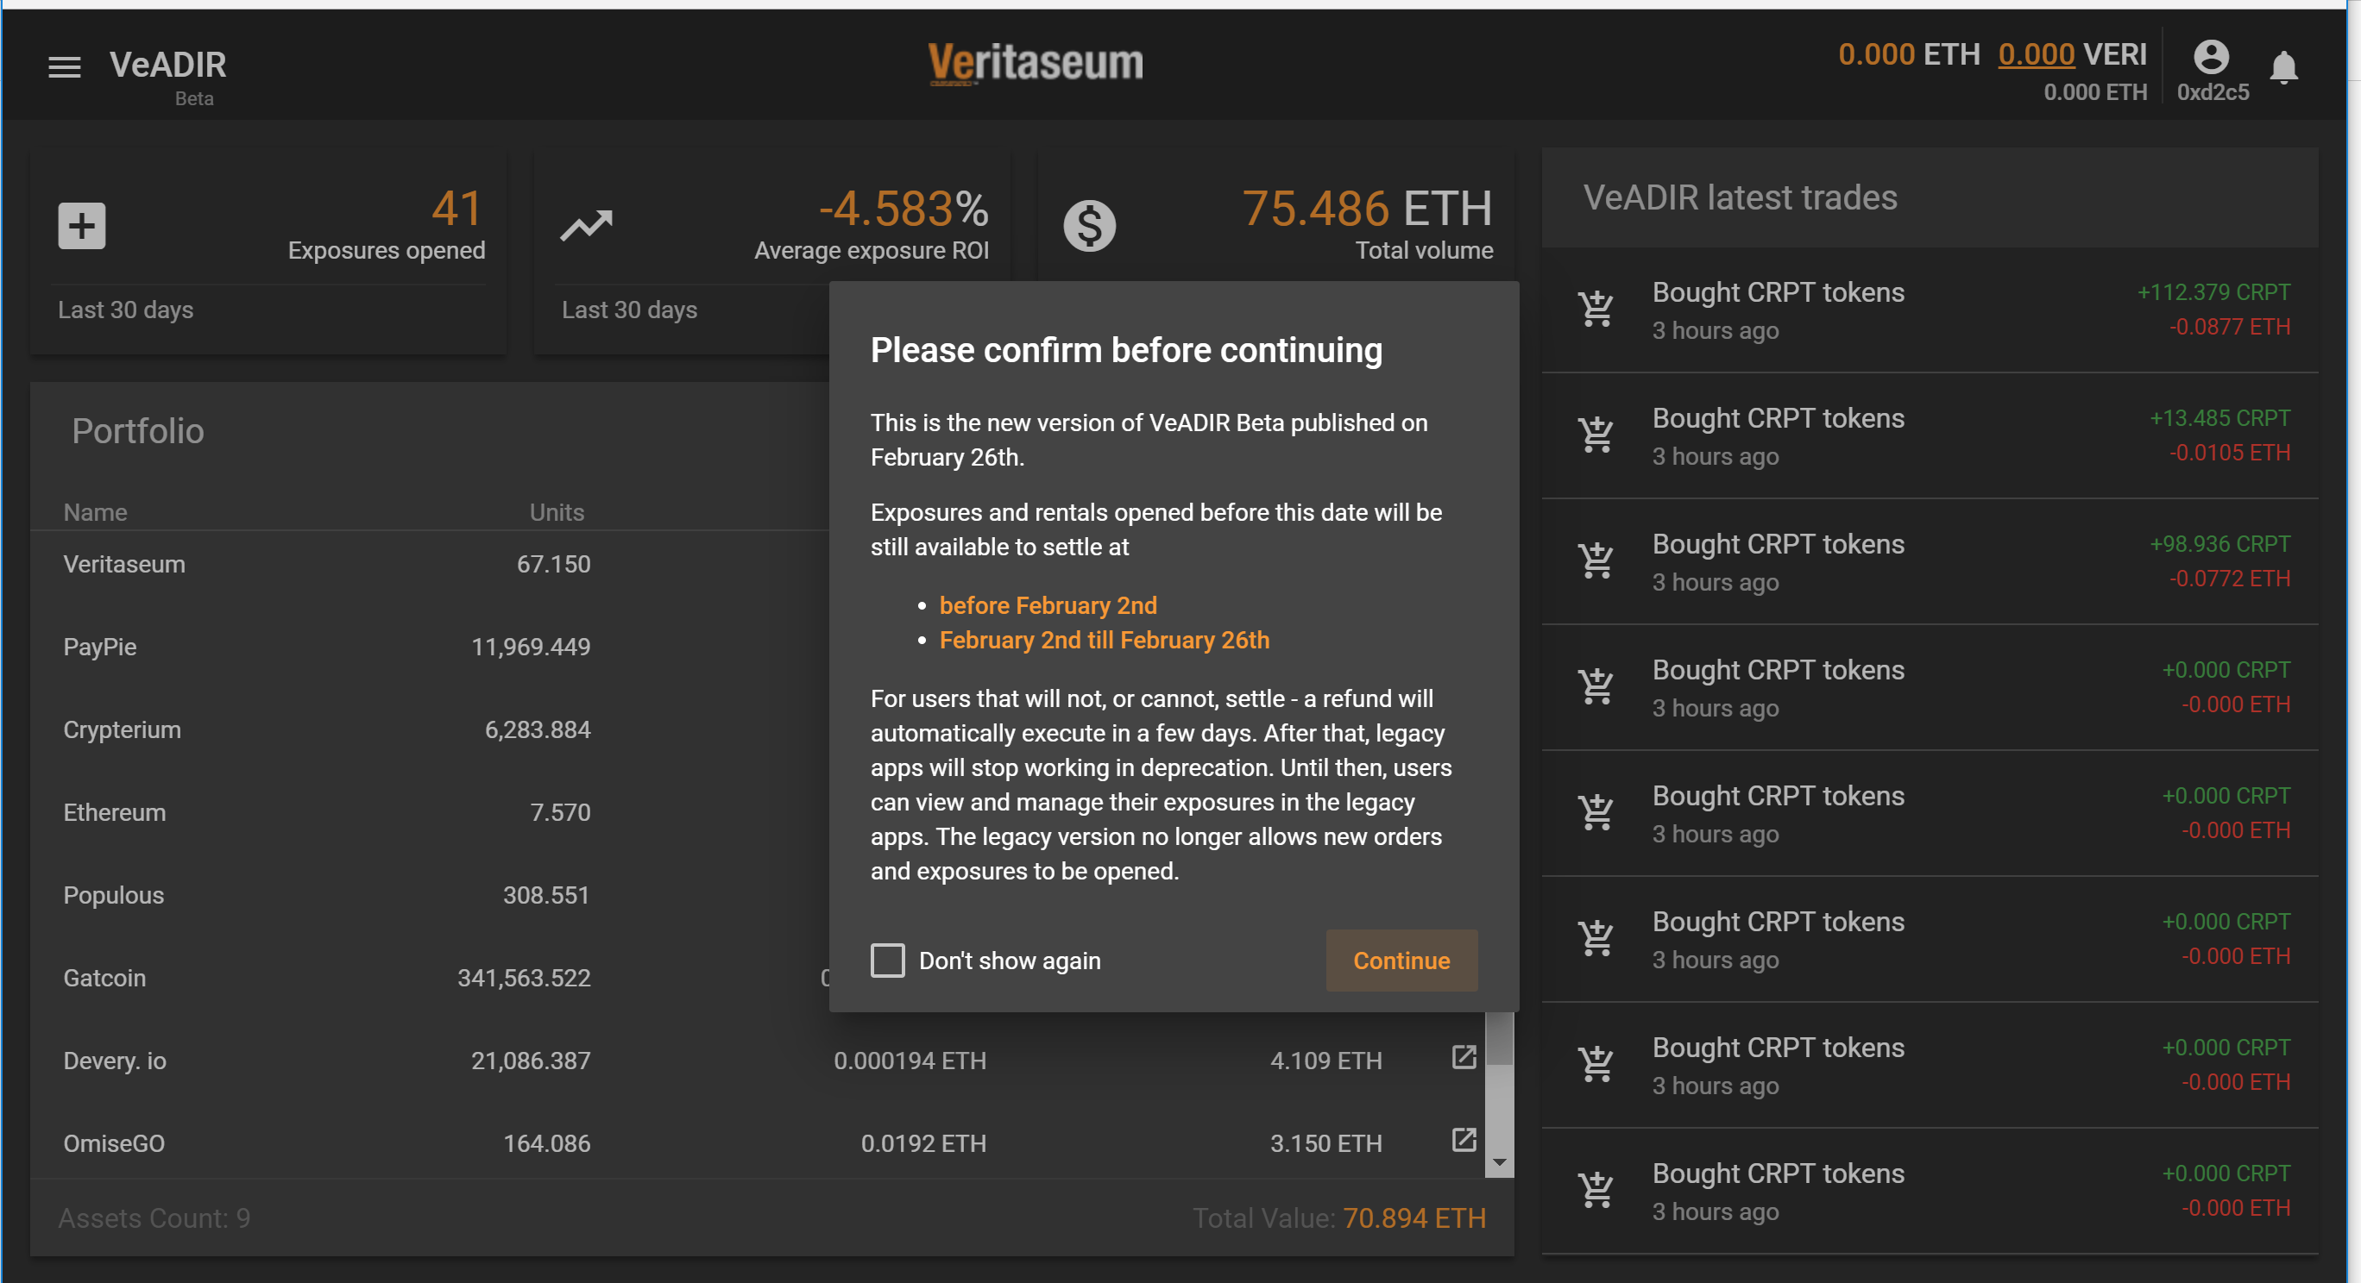
Notes:
Second beta version disclaimer

Slide 6
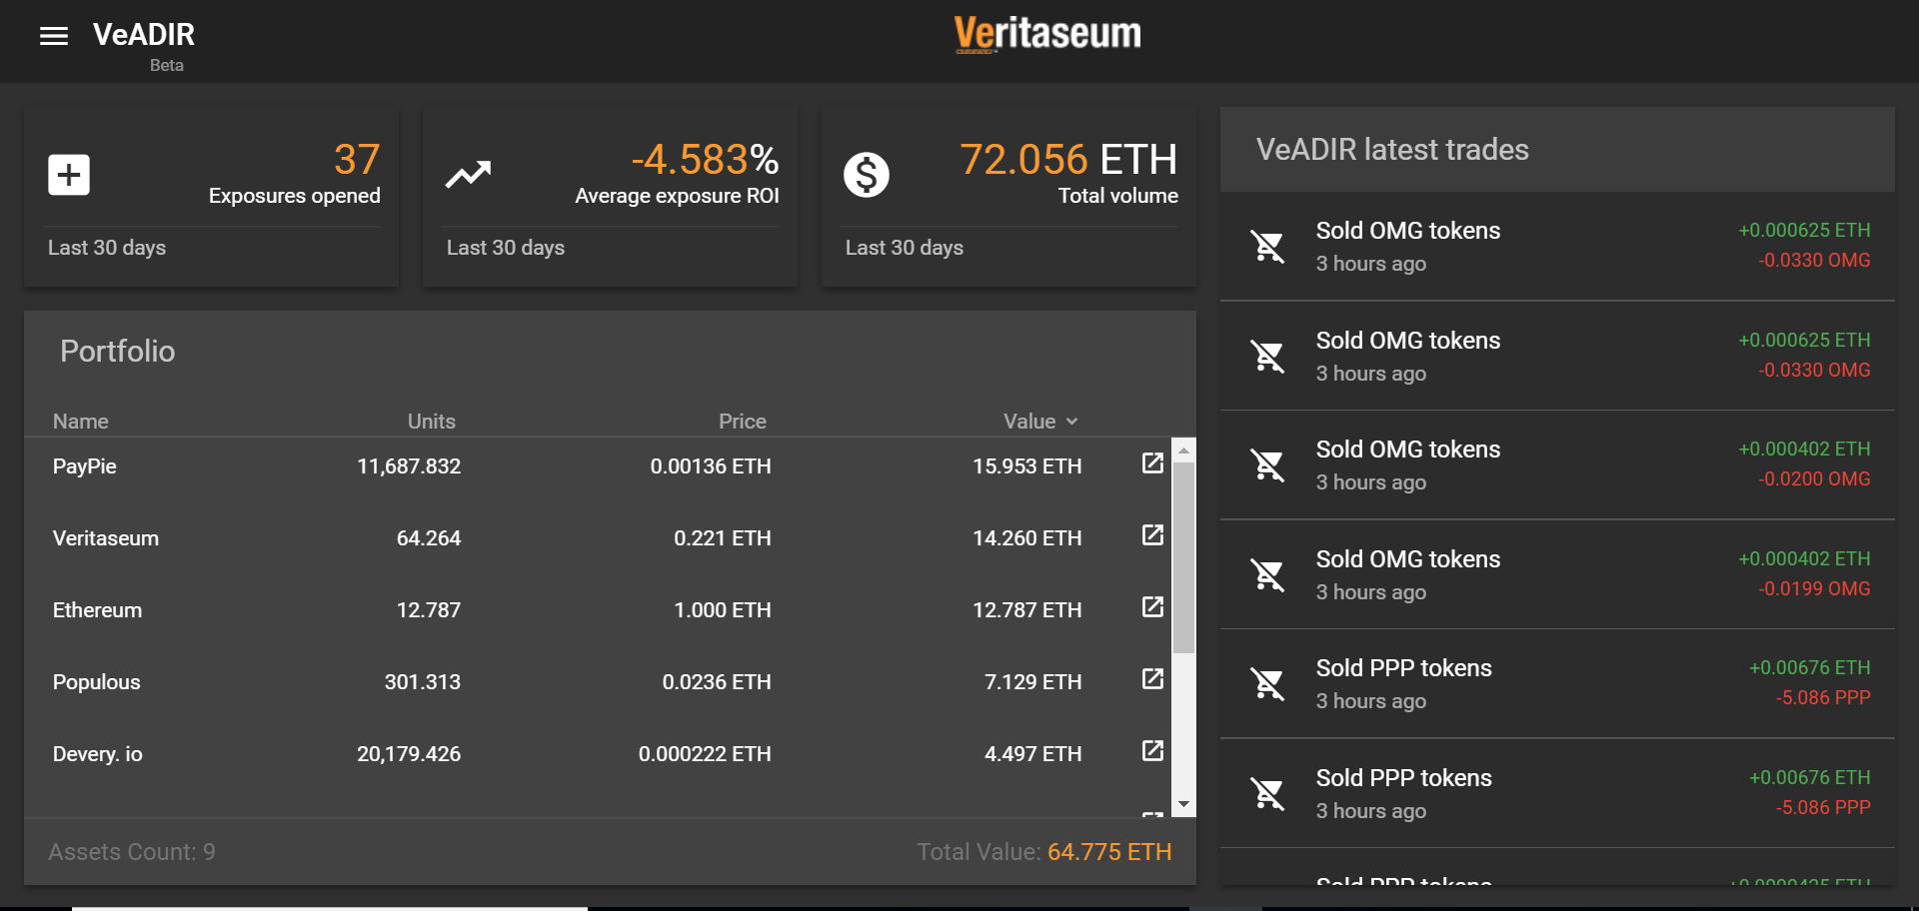
Notes:
Describe and define features on home page
Exposures opened
Average Exposure ROI
Total Volume
Portfolio
Aggregate exposures
VeADIR Latest Trades

Slide 7
Enabling VERI Tokens

Slide 8
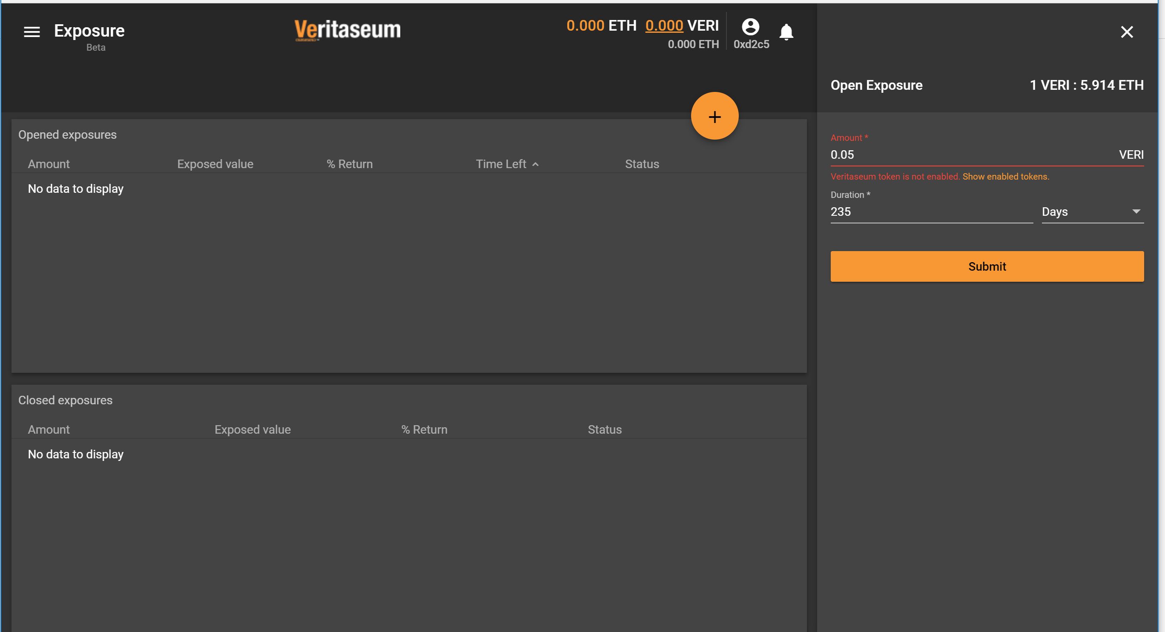
Notes:
(5) Enabling Veri Token Usage
Warning regarding un-enabled tokens
What does enabling mean?
Describe use of Veri tokens

Slide 9
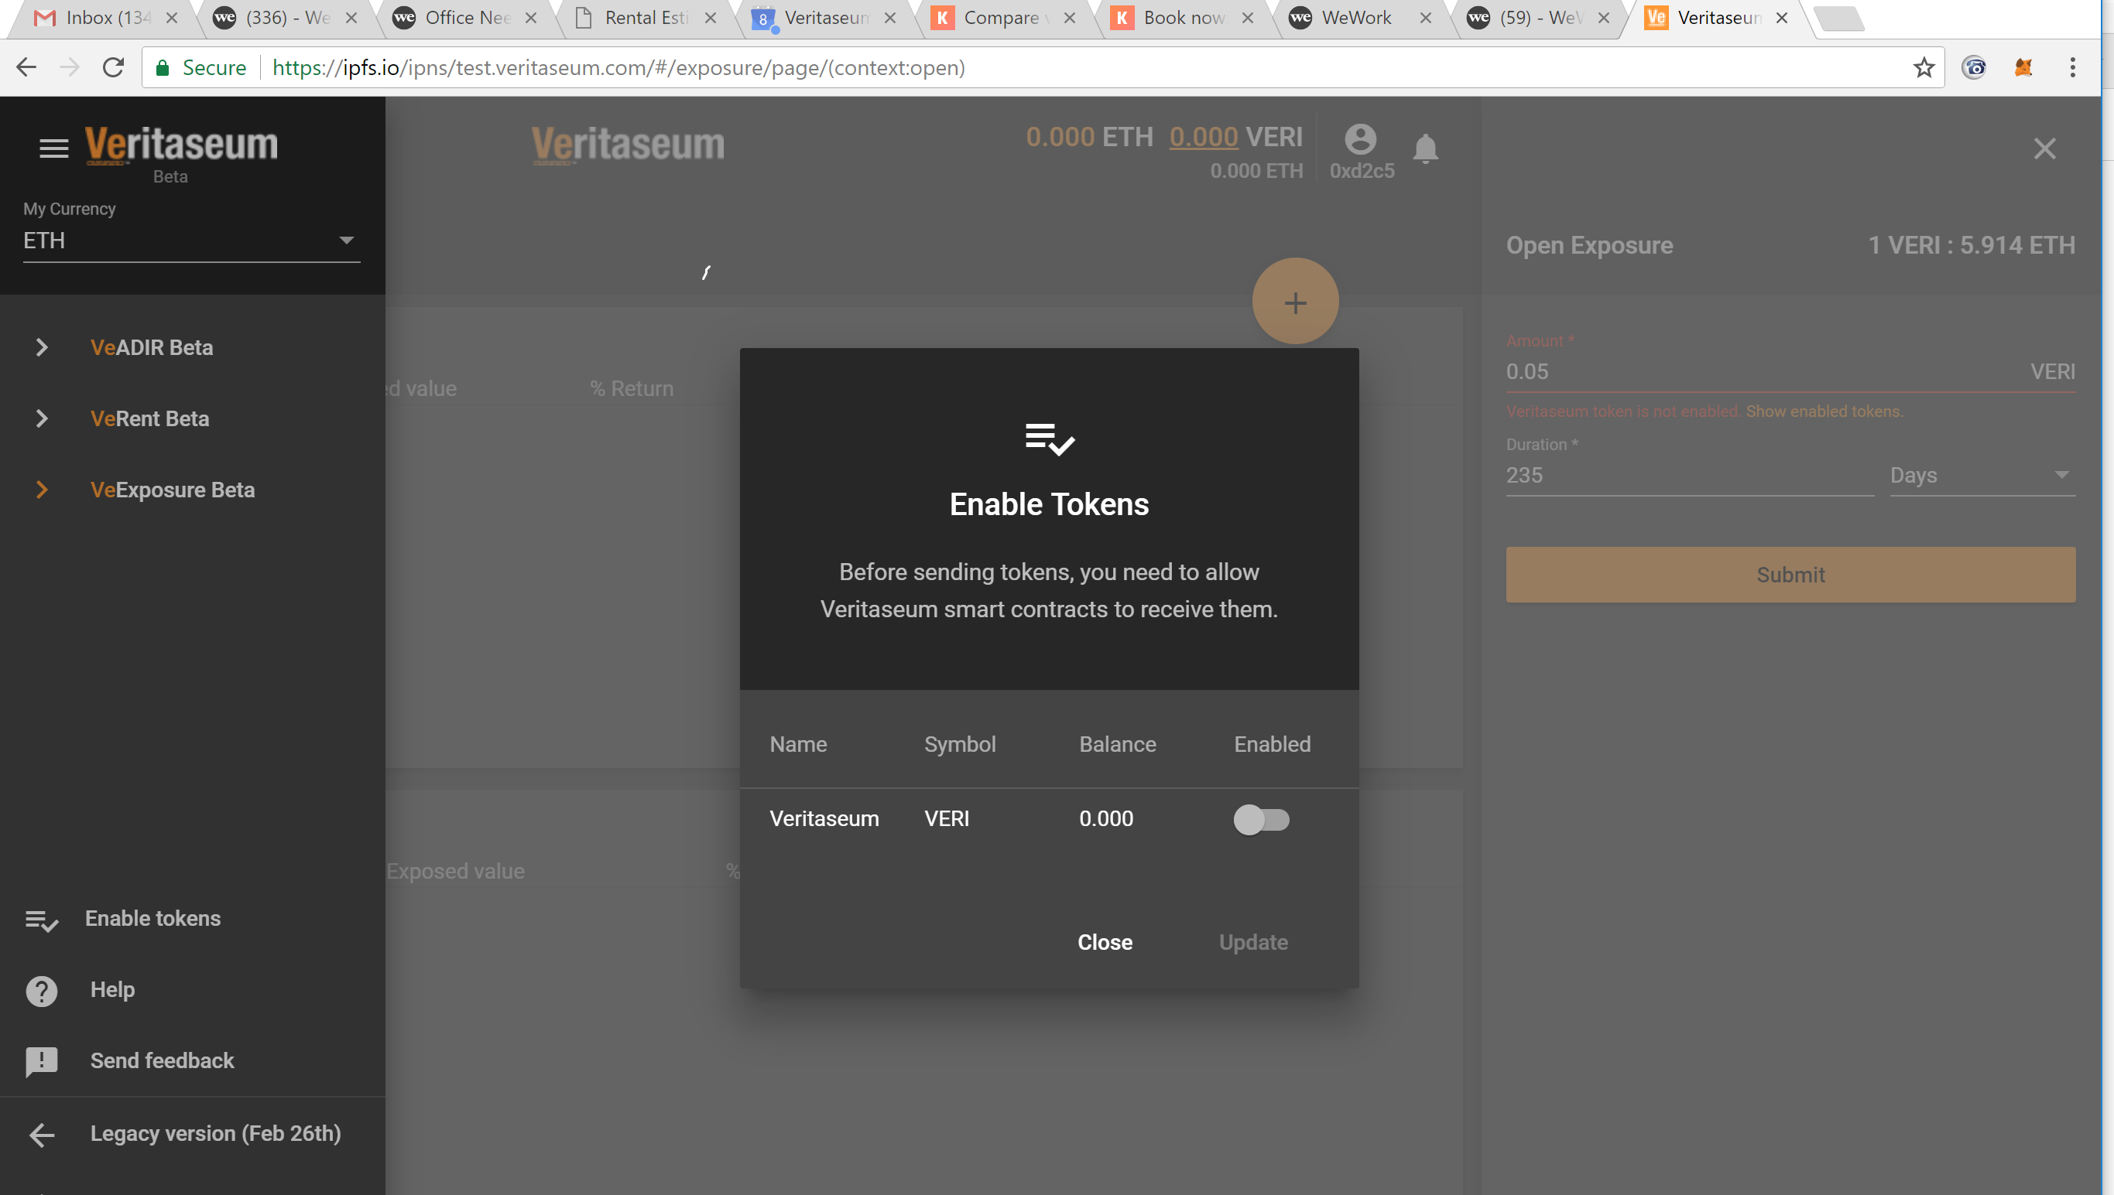
Notes:
How does user enable tokens?

Slide 10
Exposures

Slide 11
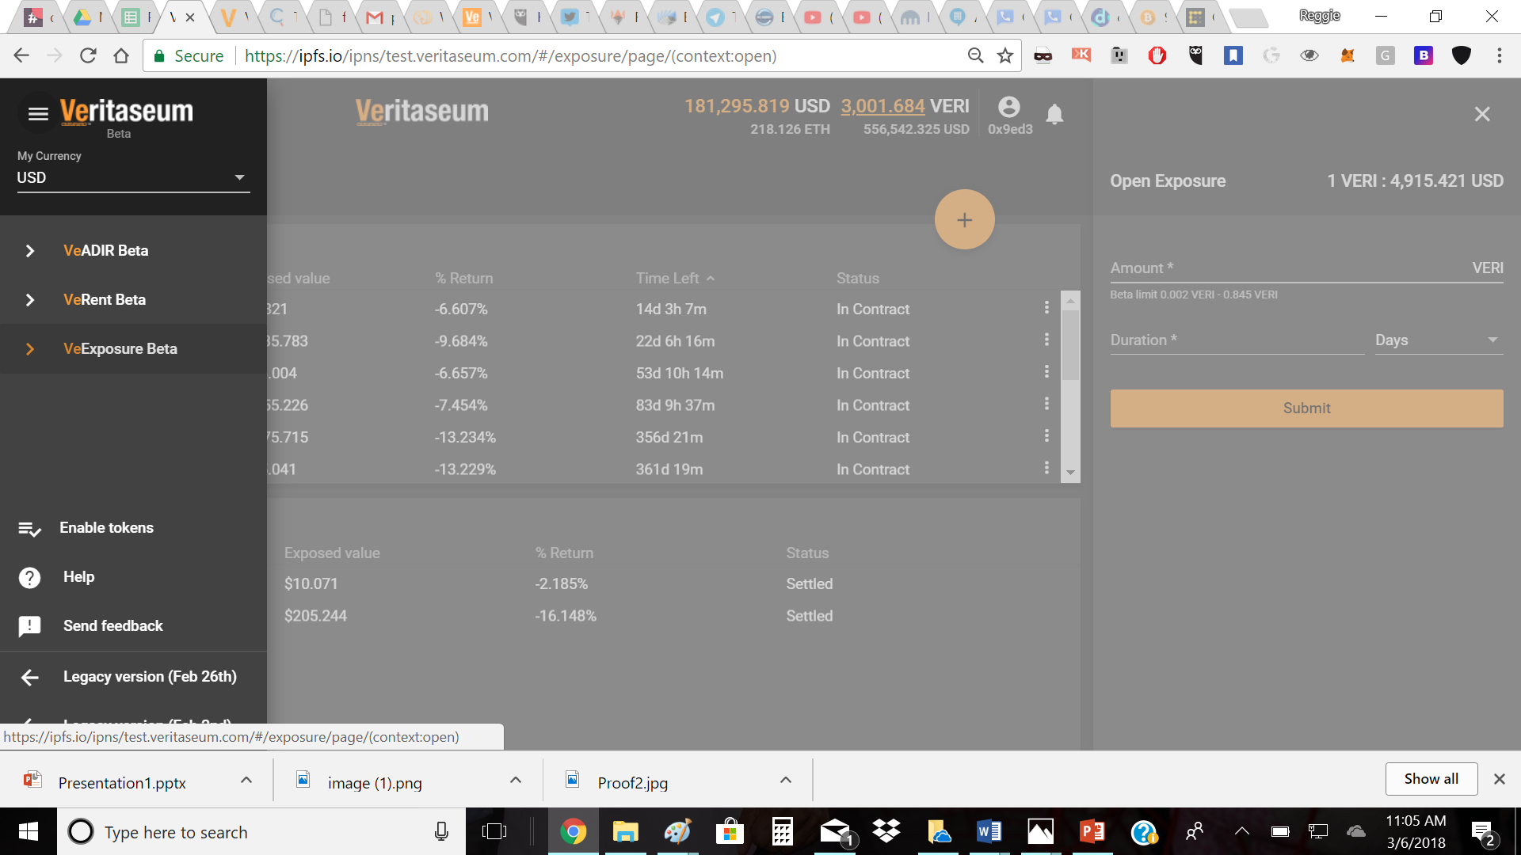
Notes:
VeExposure
Allows users to obtain “exposures” to a portfolio of digital assets

Slide 12
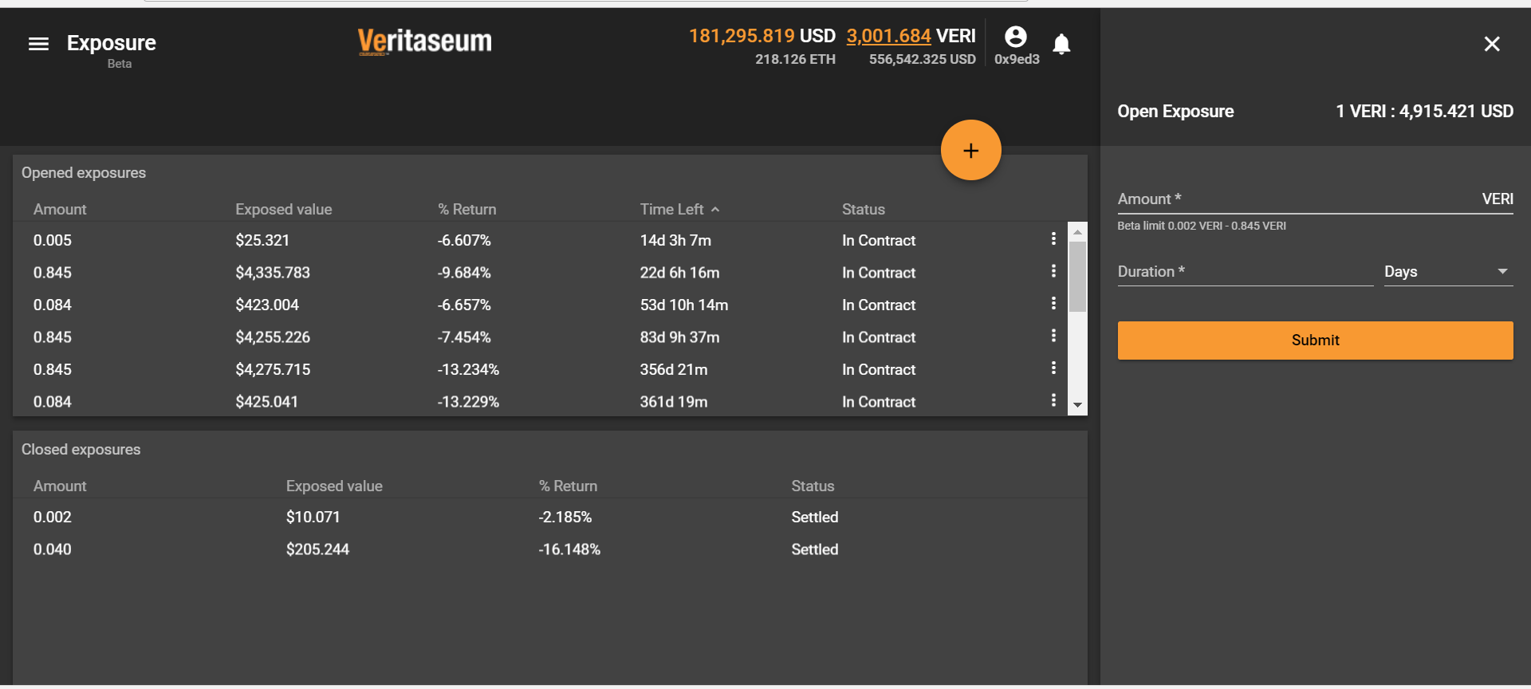
Notes:
Describe “Open Exposures”
Describe “Closed Exposures”
Explain all column headings
Amount
Exposed value
Percent Return
Time Left
Status

Slide 13
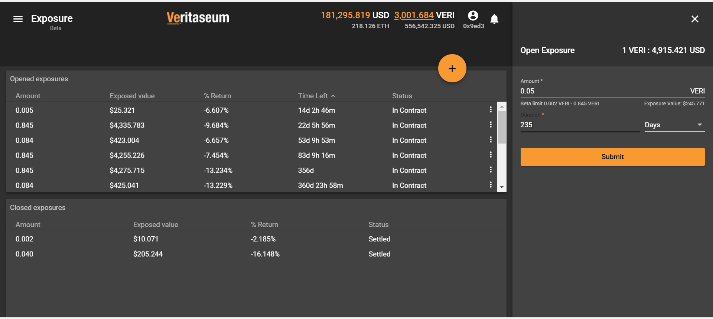
Notes:
Explain how user opens a new exposure
Describe inputs
Amount
Note limitations on exposure during beta testing, stated in right side tool bar
Duration

Slide 14
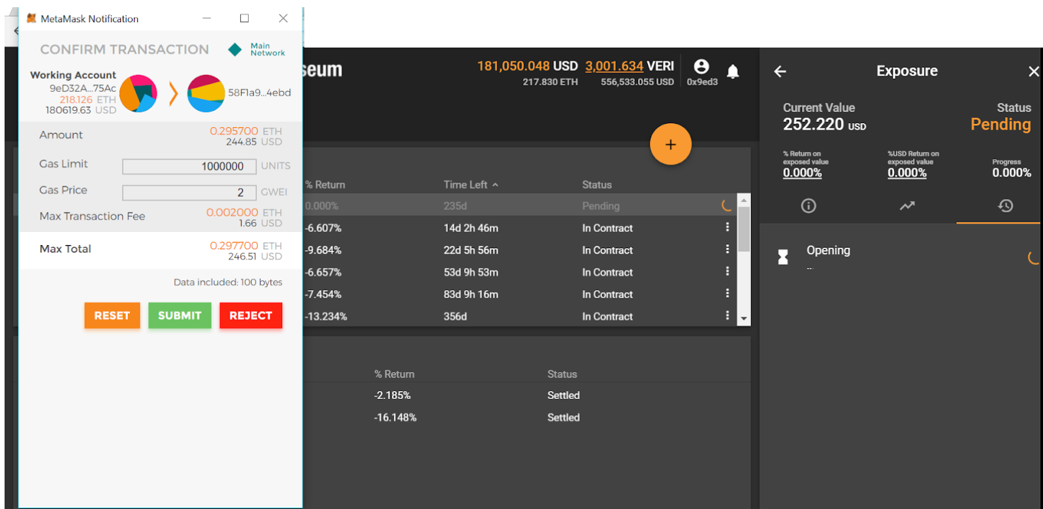
Notes:
Describe MetaMask notification
Explain “gas limit” and “gas price”

Slide 15
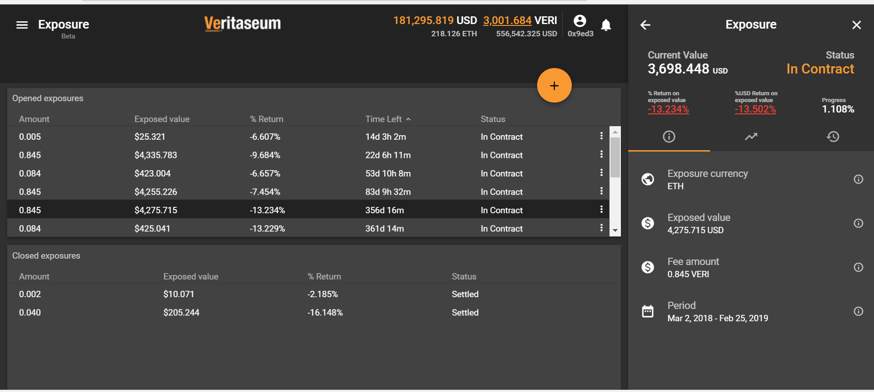
Notes:
Viewing existing exposures
Tool bar on the right (first tab)

Slide 16
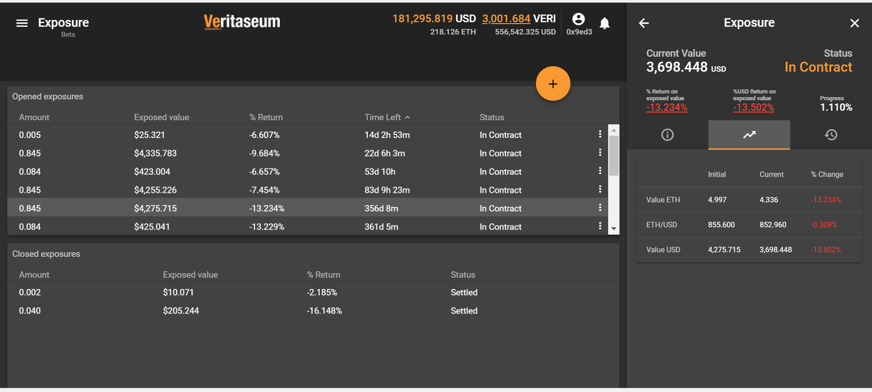
Notes:
Describe information in tool bar on right (second tab)

Slide 17
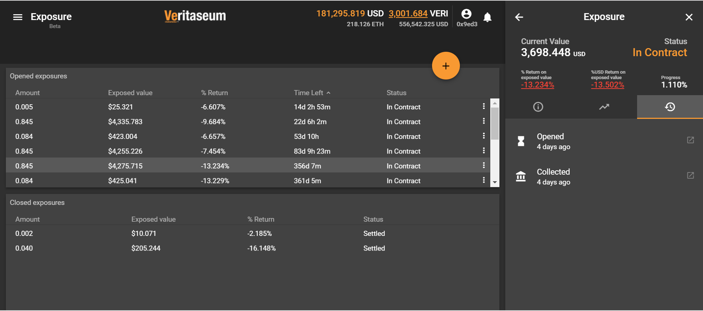
Notes:
Describe information in tool bar on right (third tab)
What does “opened” mean?
What does “collected” mean?
Click icon to show underlying block chain info (depicted next slide)

Slide 18
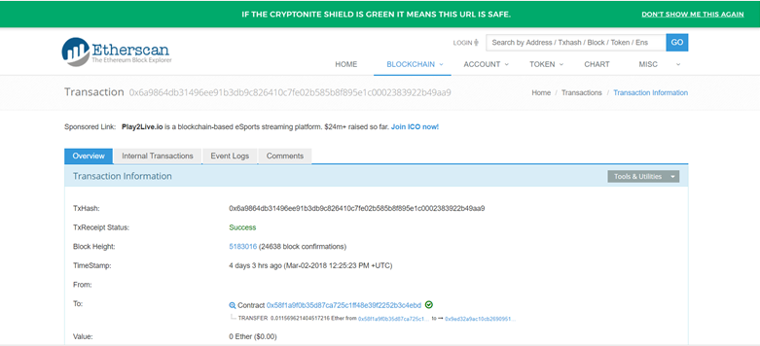
Notes:
Users can view underlying transaction block chain information for all transactions

Slide 19

Notes:
Closing an existing exposure
At contract expiration
Before contract expiration
How can users close exposures early?

Slide 20
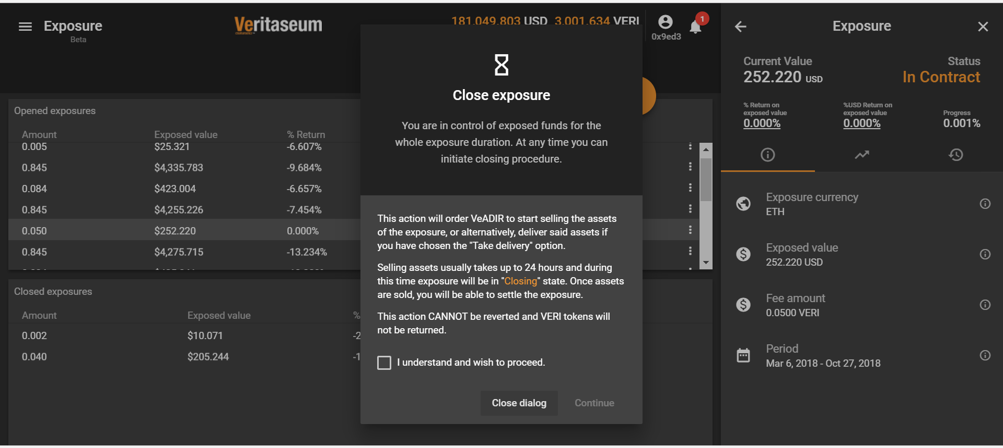
Notes:
Discuss disclaimer
“Selling assets” vs. “taking delivery”

Slide 21
Economic Rent

Slide 22
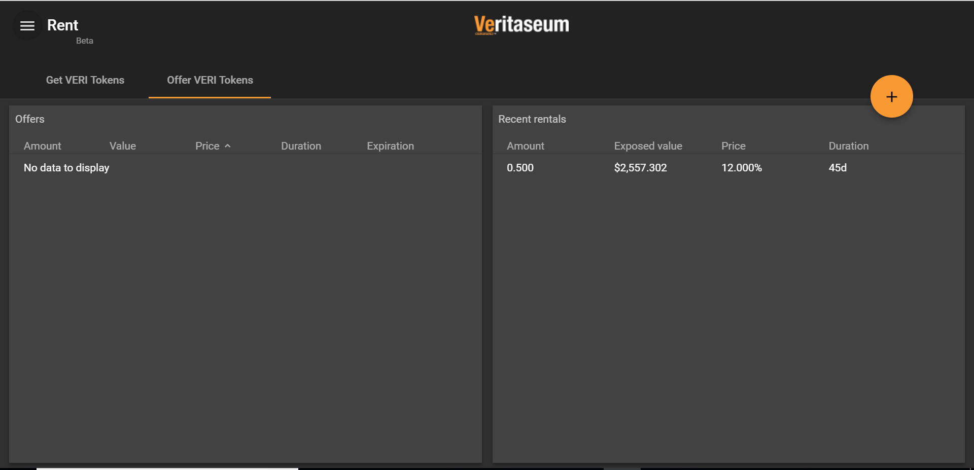
Notes:
(7) VeRent
Describe VeRent functionality
Non-Veri holders
Veri holders
“Offer Veri Token” tab
Describe columns
Account
Value
Price
Duration
Expiration
Exposed Value

Slide 23
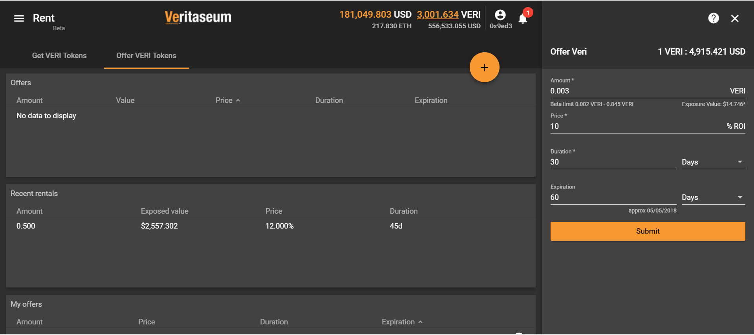
Notes:
Making a rental offer
Inputs
Amount
Price
Duration
Expiration
VERI to Dollar rate (top right)
Who sets this rate?

Slide 24
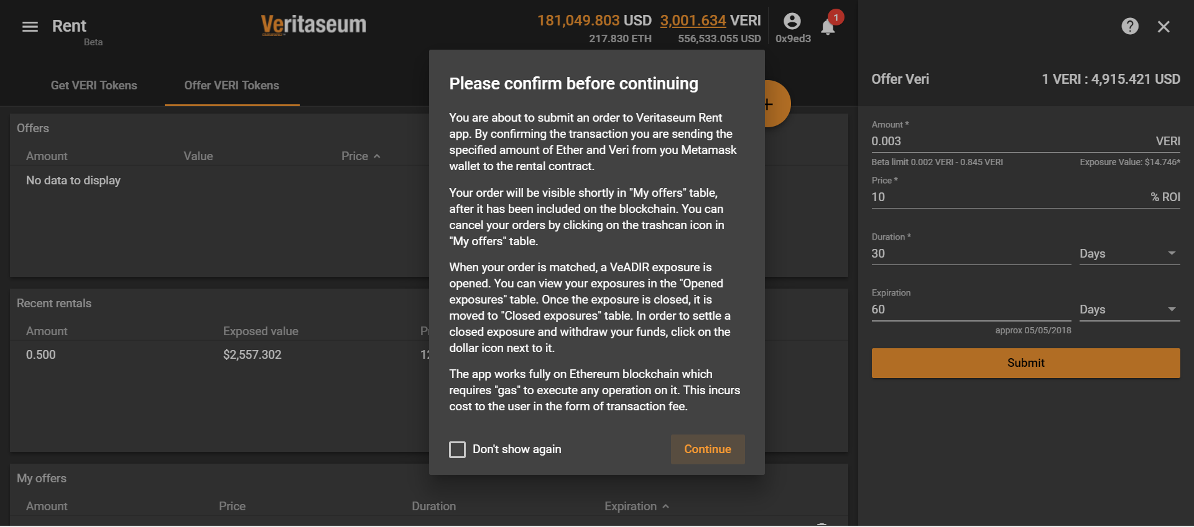
Notes:
Disclaimer before offer is finalized

Slide 25
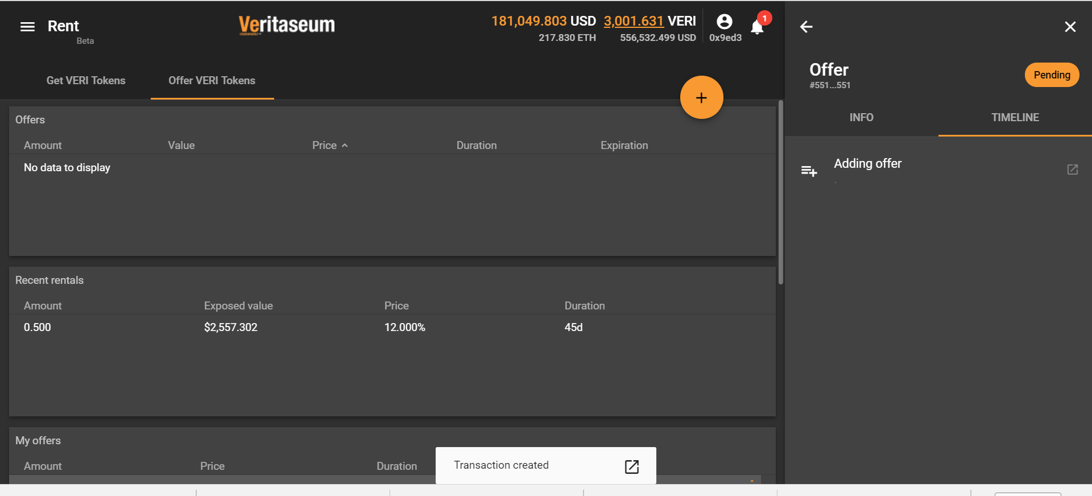
Notes:
Offer transaction created
Select icon next to Trade Completed to see underlying block chain data (depicted next slide)

Slide 26
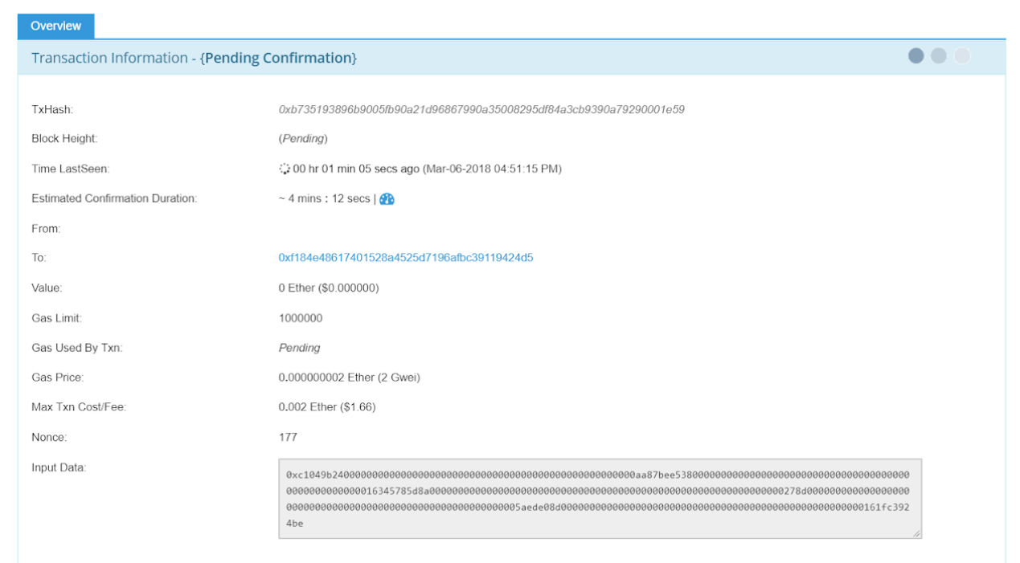
Notes:
User can see the underlying block chain information for rental offer

Slide 27
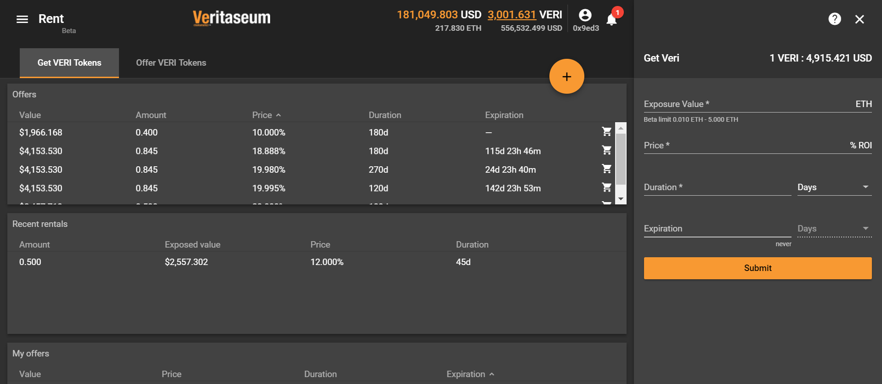
Notes:
“Get Veri Tokens” Tab
Accepting rental offers

